Slide 1


School of Engineering and Technology
Phishing Detection in Email using
Deep learning

Slide 2

INTRODUCTION
S.No
S.No | NAME | ROLE
1. | Vanshika Sharma (2301010368) | Report,Research work,Exp 1{Glove Embedding}
2. | Srishti Verma (2301010350) | Presentation2,{Word2Vec}
3. | Aman Singh (2301010352) | Presentation1,{FastText based}
All three have sincerely supported and assisted one another throughout the project, and their cooperation is deeply appreciated

Slide 3
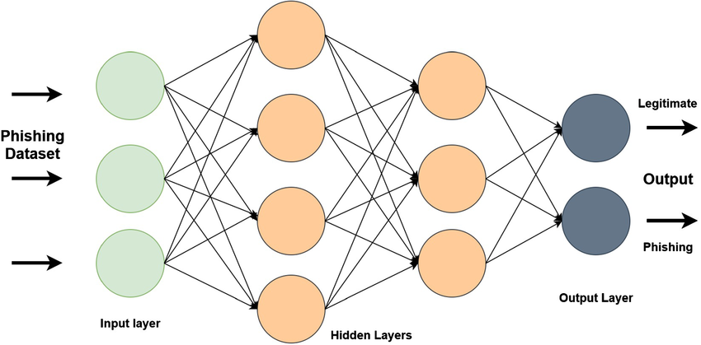
Introduction
Email’s widespread use has made it a prime target for phishing attacks, which pose serious risks to individuals and organizations by stealing sensitive information like passwords and financial details. Traditional detection methods often fall short against increasingly sophisticated threats. This mini-project aims to apply deep learning techniques to improve phishing detection in emails. By leveraging neural networks to analyze email content and metadata, we seek to build a more accurate and adaptive system. The project explores architectures like RNNs and CNNs to enhance email security through intelligent threat identification.

Slide 4
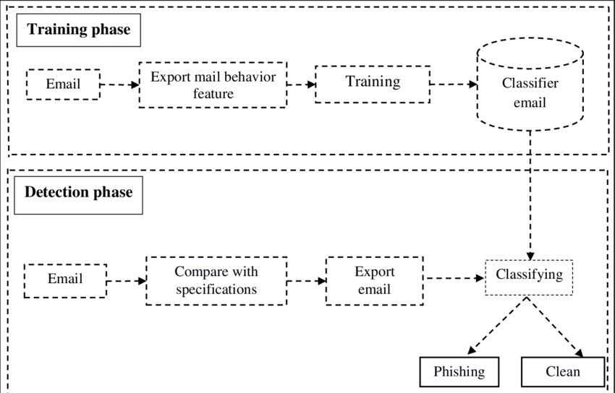
Problem Statement
This study aims to develop a deep learning-based phishing detection model using NLP, CNNs, and RNNs to analyze email content and metadata, enhancing accuracy and reducing false alerts.
Notes:
New Courses replaced with New Programmes

Slide 5
Methodology and Implementation
Dataset Collection – Gather phishing and legitimate emails from a public dataset.
Dataset used in project-"C:\Users\verma\Desktop\spam 3 - Copy.csv"
2. Emails Preprocessing – Clean the text, remove duplicates, and ensure class balance.
3. Model Training & Optimization – Train deep learning models (CNNs, RNNs) to detect phishing patterns.
4. Feature Extraction – Convert email content and metadata into numerical representations for analysis.
5. Classification – The model predicts whether an email is phishing or legitimate.
6. Phishing Email – If classified as phishing, it is flagged as a threat.
7. Safe Email – If classified as legitimate, it proceeds to evaluation.
8. Evaluation– Assess model performance using accuracy, precision, recall, and F1-score.
Notes:
New Courses replaced with New Programmes

Slide 6
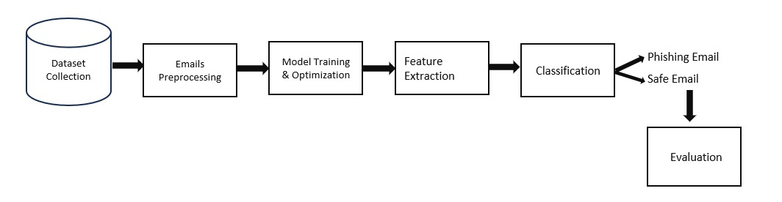
Demonstration
Notes:
New Courses replaced with New Programmes

Slide 7
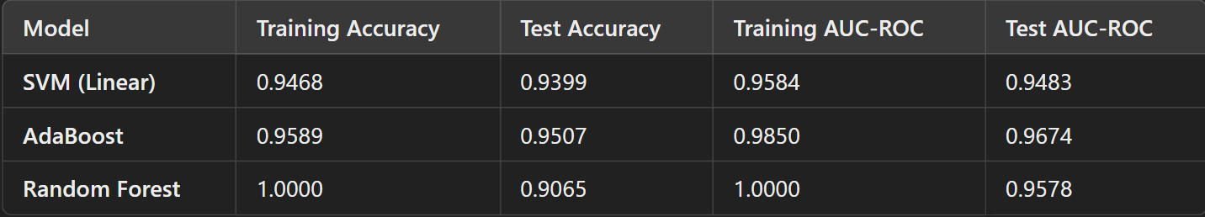
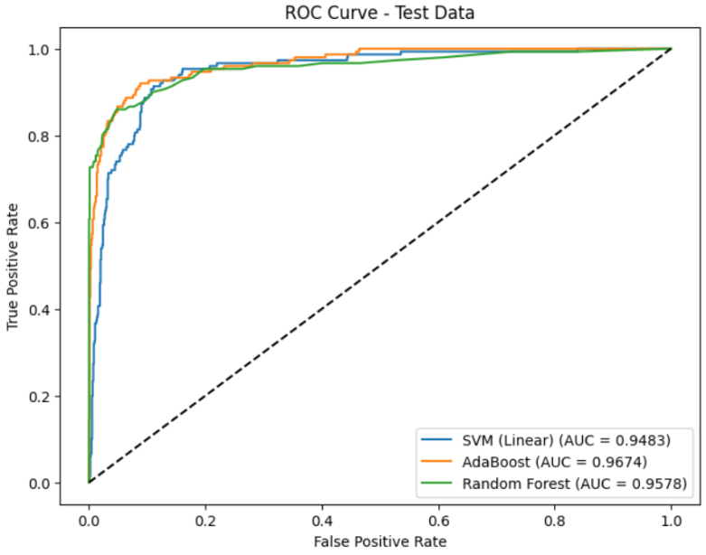
Result and Discussion
Experiment 1: GloVe-Based Spam Email Classification
GloVe embeddings transform email text into numerical vectors for spam classification using SVM, AdaBoost, and Random Forest models
.

Slide 8
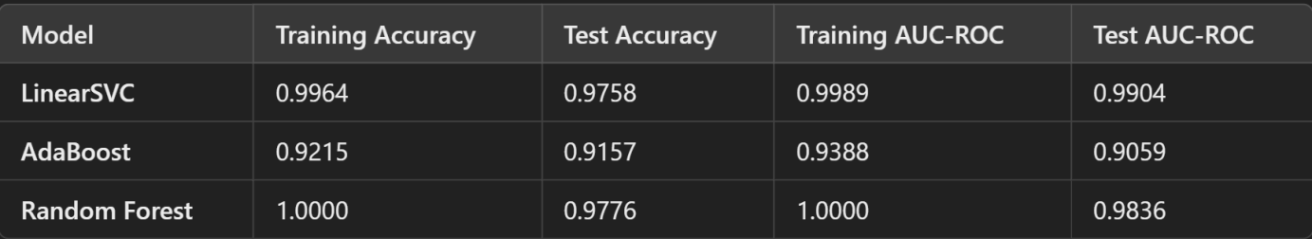
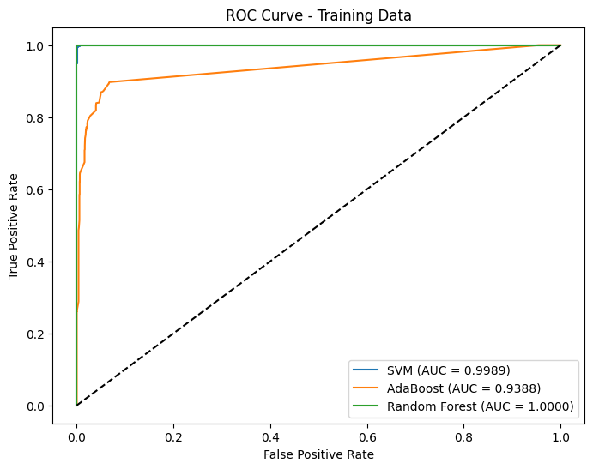
Experiment 2 :FastText-Based Spam Email Classification
Random Forest and LinearSVC outperform AdaBoost in spam classification, with Random Forest excelling in feature importance and generalization, while LinearSVC demonstrates strong discrimination capabilities.

Slide 9
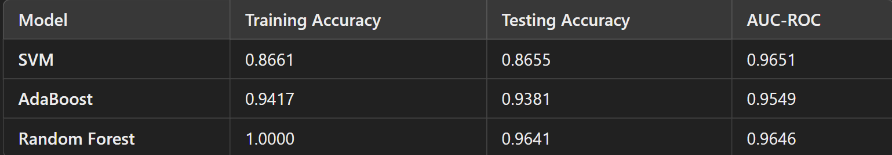
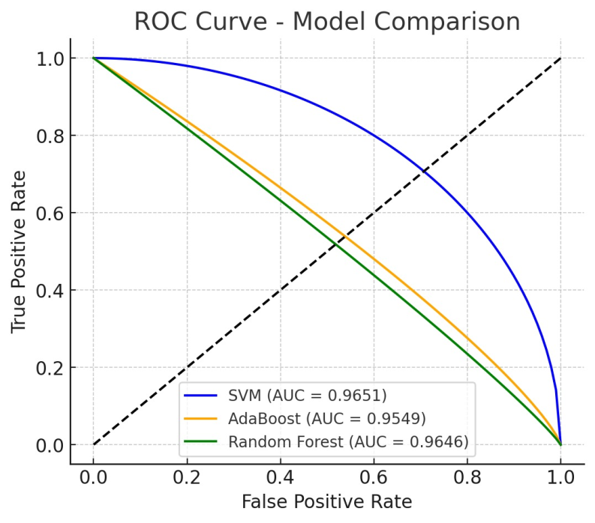
Experiment 3: Word2Vec-Based Spam Email Classification
Using GloVe embeddings for spam classification, Random Forest outperforms SVM and AdaBoost in accuracy, while SVM excels in ranking emails with the highest AUC-ROC score.

Slide 10
Conclusion
In conclusion, this project has illuminated deep learning's substantial potential in enhancing defenses against the escalating threat of email phishing. By leveraging neural networks' capacity to discern intricate patterns in email data, we've demonstrated the feasibility of developing more sophisticated and robust detection systems.
The findings suggest that deep learning models offer a promising and potentially transformative alternative to traditional rule-based methodologies, which often struggle to maintain efficacy against increasingly sophisticated and adaptive cybercriminal tactics. Specifically, the project has [mention 1-2 key outcomes, e.g., demonstrated the effectiveness of a specific deep learning architecture, or highlighted the importance of certain email features].
While these results are encouraging, the ongoing battle against phishing necessitates continuous vigilance and innovation. Future work could usefully focus on several key areas, including:
Real-time detection: Developing systems capable of analyzing emails in near real-time to proactively prevent user victimization and minimize potential harm.
Explainable AI: Investigating methodologies to enhance deep learning models' transparency and interpretability, enabling security analysts to better understand factors contributing to an email's phishing classification.
.
Notes:
New Courses replaced with New Programmes

Slide 11
THANK YOU

